Slide 1
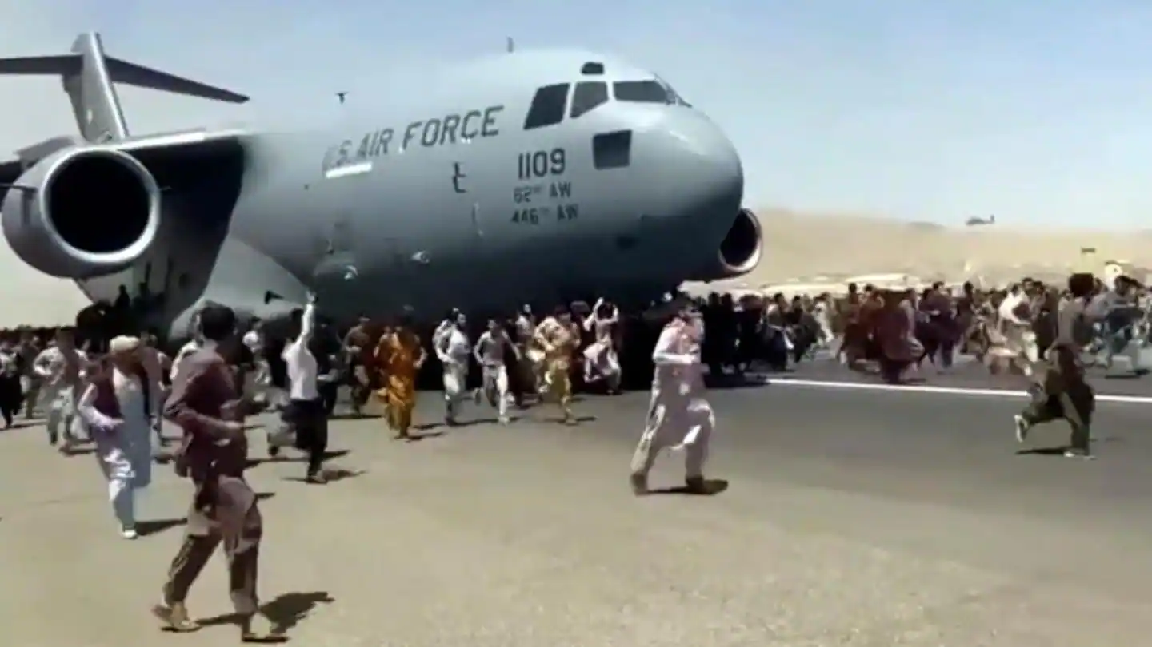
(psst…don’t bring your luggage to the NSO…)
NLOC PHASE 6 “TRANSITION”

Slide 2
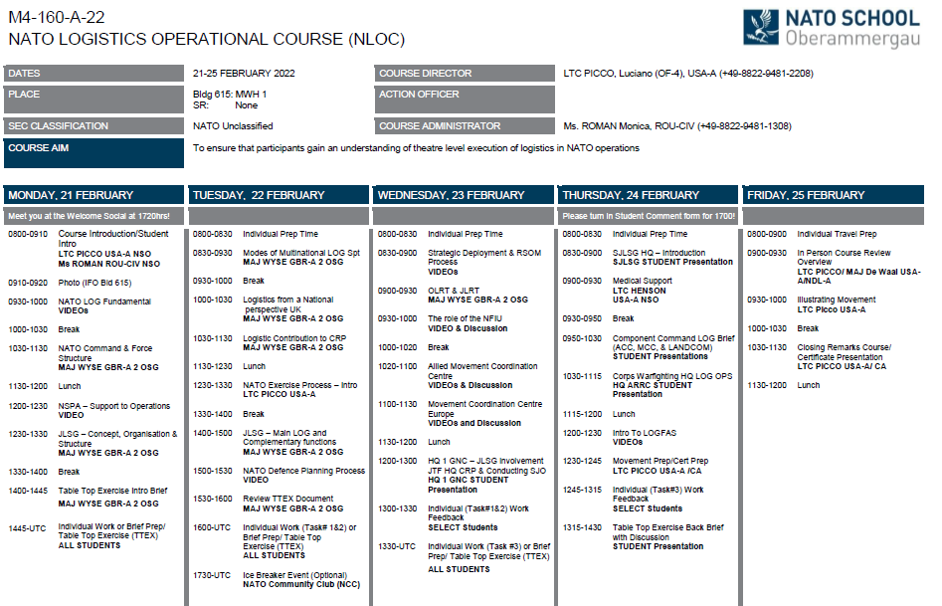
What we accomplished
NATO UNCLASSIFIED

Slide 3
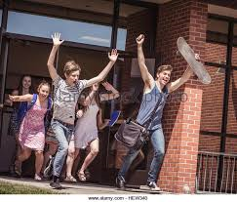
(psst…don’t bring your luggage to the NSO…)
A few things before we go…

Slide 4
*Note: don’t bring your luggage to the NSO
Friday’s Uniform:
1) Military Uniform (same as always!)
2) After conclusion of course students may change into clothing for travel (NSL provides luggage storage and changing room)
3) You may drop bags at the NSL on Friday morning

Slide 5
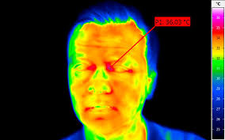
Temperature Check
Tomorrow morning
Same process as:
Sunday In-processing
Monday morning Temp Check
Important: NATO School Oberammergau does not collect any personal data

Slide 6

Friday’s End-of-Course Schedule
Return & sanitize electronic Badges
Return & sanitize door and coffee Keys
Course Certificates / Course Picture
Please check your Rank and Name on the Course Certificate

Slide 7
Friday Admin Schedule:
Presentations:
Student In Person Course Review-
Illustrating Movement to Non-Movers –
DO NOT BRING LUGGAGE TO NSO
1300 hrs – Departing from NSL - Express Bus to Munich airport

Slide 8
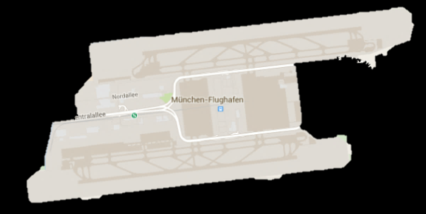

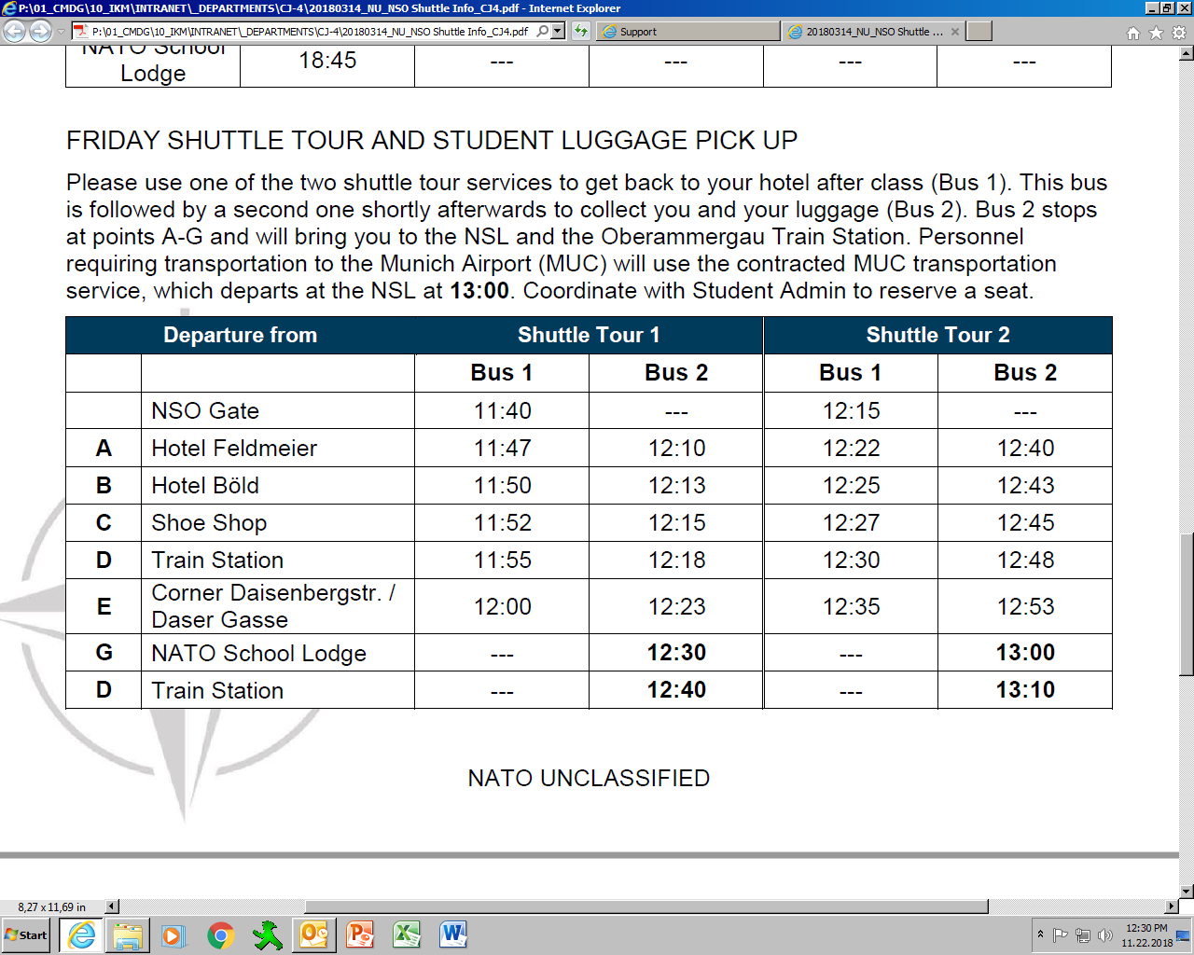

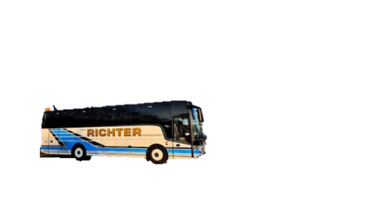
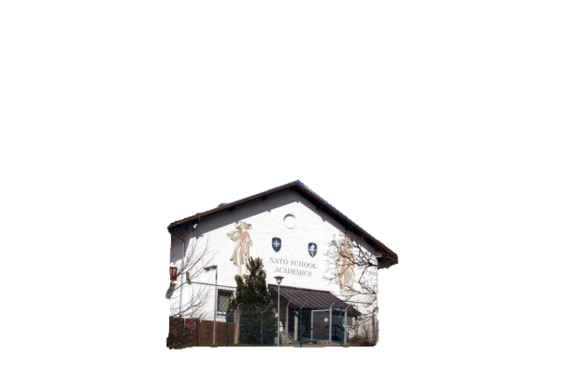

Munich Airport Express Shuttle Bus
Departs NSL Friday at 1300
DO NOT BRING LUGGAGE TO NSO
Notes:
“This is a better option for Fridays as the Train takes the long (slow) way to Munich Airport. timings of pick-up and drop-off are on your Bus Schedule.
Please see Student Admin by Close of Business Wednesday to sign up for the shuttle and pay the fee.”

Slide 9
DO NOT BRING LUGGAGE TO NSO

Slide 10
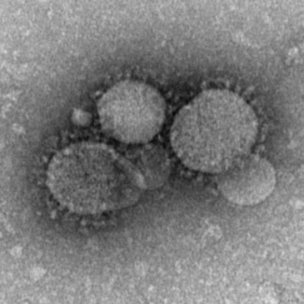
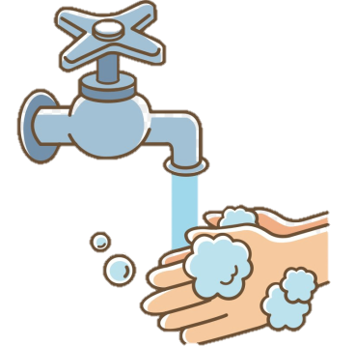
Infection Prevention
NSO is closely monitoring the Novel Coronavirus Outbreak
NSO Post-Course Procedures
PLEASE LET US KNOW IF YOU BECOME ILL WITH COVID-19 IN THE WEEKS FOLLOWING YOUR VISIT TO NSO
YOUR COURSE DIRECTOR WILL CONTACT YOU POST-COURSE TO ASK FOR AN UPDATE; NSO REQUIRES YOUR RESPONSE!

Slide 11
Information Bring your Magnetic access badges. tomorrow morning. You will trade them for your graduation certificate. No Badge = No Graduation! : )

Slide 12
Student Comment Survey Online …

